Slide 1
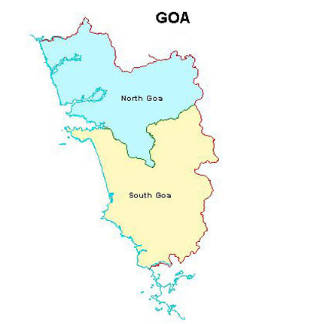
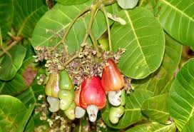
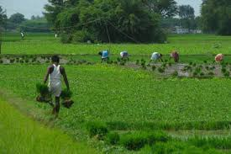
Directorate of Education Government of Goa MID DAY MEAL SCHEME

Slide 2
Brief History
Prior to 2003, in the State of Goa, 3 kgs of rice was distributed to primary students under Mid Day Meal Scheme.
In 2003-04, Kachori, Ladoos, Chakli, Shankar Pali, Biscuits, etc. were distributed.
In 2005-06, items such as Bhaji Pao, Vegetable Pulao, Shira, Pohe, Upama & Moong Bhaji Pao were served .
Tenders were invited Taluka-wise from local Self Help Groups to serve hot cooked food to the children of Govt/Govt Aided schools to implement Mid Day Scheme under Centrally sponsored Scheme of MHRD from the year 2005
At present there are 105 Self Help Groups/Mahila Madals and Seven P.T.A’s supplying Mid Day Meals in all the 12 Talukas of the State.

Slide 3
MENU FOR MID-DAY MEAL
Earlier Menu | Existing Menu
Bhaji Pav/Puri/Chapati Vegetable Pulao | Chole Bhaji & Pav/Poli Masoor Bhaji & Chapati 3. Red chowli Bhaji & Chapati 4. Chana Bhaji & Pav/Poli 5. Chana-Kuleeth Mix Bhaji & Pav/Poli 6. Chowli-Paute Mix Bahaji & Chapati

Slide 4
INSTITUTIONS
STAGE | PAB APPROVAL 2018-19 | COVERAGE | REMARKS
PRIMARY | 1041 | 1035 | 6 Govt. Primary Schools are closed/amalgamated in neighboring Schools.
UPPER PRIMARY | 438 | 438 | -

Slide 5
APPROVAL V/S ACHIEVEMENT FOR THE YEAR 2018 – 19.
NO. OF CHILDREN
 | ENROLLMENT | AVERAGE | PAB APPROVAL
PRIMARY | 95,330 | 86,327 | 87,000
UPPER PRIMARY | 66,393 | 55,137 | 58,500

Slide 6
WORKING DAYS
PAB APPROVAL FOR 2018-19 | COVERAGE FOR 2018-19
220 days | 221 days

Slide 7
MDMS Administrative Setup
(State Nodal Officer)

Slide 8
Flow of Funds
CENTRAL GOVT RELEASES FUNDS AS PER ALLOCATION
BILLS OF SELF HELP GROUPS ARE SUBMITTED BY THE TALUKA ADEIs
STATE TREASURY RELEASES STATE SHARE FUND
DIRECTORATE OF EDUCATION SCRUTINIZES AND SUBMITS THE BILLS TO THE DIRECTORATE OF ACCOUNTS FOR FINAL PAYMENT TO SHG,FCI, TRANSPORTER
HELPERS – Rs.1000 per month
PAYMENTS IS DONE THROUGH ECS TO THE SELF HELP GROUPS, FCI, TRANSPORTER ON MONTHLY BASIS

Slide 9
Supply of Meals
105 Self Help Groups/Mahila Mandals and Seven P.T.As supply meals to the schools.
Selected after inviting applications from eligible Self Help Groups fulfilling following conditions:-
License from Directorate of Food and Drugs Administration.
Group registered with Registrar of Society Act under Societies Act 1860.
Taluka wise Residence Certificate of the Self Help Group is obtained.
Meals are supplied to children during the interval/recess period.

Slide 10
Checking Quantity and Quality
F.C.I. Depot (Food grain)
Quality Control Officer of FCI and Vocational Education Officer (VEO)
Samples are stored in the Directorate of Education.
Self Help Groups are provided with the samples to cross check the quality at the time of receiving the food grains from the civil supply godown/s.
Kitchen (Preparation)
Inspected by:
Officials from the Directorate of Food and Drug Administration.
Assitant Director of Education (Voc)
Vocational Education Officer (VEO)
Heads of the Schools
A.D.E.I.s of respective Taluka.
Health Officer.
Block Resource Person/Cluster Resource Person of Sarva Shiksha Abhiyan.
Nutrition experts

Slide 11
Checking Quantity and Quality (Contd..)
School Level (Hot Cooked Food)
Head of the school checks for Quantity and Quality of the food received for the day from the Self Help Group.
One member of the P.T.A. and Class Teacher test and tastes the meal before serving to students.
Taluka A.D.E.I.s visit one school per day of their jurisdiction.
Nutrition Experts
Education Officers who are on tour.

Slide 12
Grievance Redressal System
D.E.O. FOR NORTH ZONE
D.E.O. FOR SOUTH ZONE
D.E.O. FOR CENTRAL ZONE
TALUKA ADEI FOR TALUKA

Slide 13
School Health Programme
* Source: Data provided by Directorate of Health Services
The Programme is carried out by Directorate of Health Services and submit the report to the Directorate of Education on quarterly basis.
Some schools are visited more than once.
The information for the year 2018-19.
Students of std IX to X are also supplied de worming tablets.
Students from std I to XII are supllied with spectacles
 | 2017-18 |  | 2018-19
 | Schools covered | No of Students | Schools covered | No of Students
Iron , folic Acid | 527 | 90,663 | 1,390 | 2,73,254
De worming Tablets | 1,750 | 2,74,679 | 527 | 1,40,681
Dist of Spectacles | 357 | 482 | 341 | 37.992

Slide 14
Budget Provisions for the year 2018-19 ( ` in Lakhs)
Schools | Budget Provision 2018-19
Primary | 1200.00
Upper Primary | 1500.00
Grand Total | 2700.00

Slide 15
Details of the food grains Released / Utilised for Primary & Upper Primary stage upto Mar. 19 (In metric tonnes)
 | Allocated | Lifted (upto 31-03-2019) | Utilised (upto 31-03-2019) | % Utilization (upto 31-03-2019)
 | Wheat | Wheat | Wheat | Wheat
Primary Stage | 1069.05 | 1069.05 | 1067.93 | 99.89%
Upper Primary Stage | 1930.51 | 1930.51 | 1827.79 | 94.68 %

Slide 16
Central Assistance for 2018-19 for MDMS (Pry & Upp. Pry) ( ` in lakhs)
Component | PAB Allocation | Released | Expenditure | % Utilization (upto 31-03-2019)
Cost of Food Grains | 76.89 | 76.89 | 76.89 | 100%
Cooking Cost | 1002.76 | 1058.55 | 974.38 | 92.04%
Transport Assistance | 28.84 | 28.84 | 28.84 | 100%
MME | 60 | 60 | 41.33 | 68.89%
Honorarium to cook cum helper | 166.62 | 162.36 | 130.99 | 80.67%
Total | 1335.11 | 1384.51 | 1252.43 | 90.46%
Opening Balance of MME was 19.02 Lakhs
MME Released during 2018-19 is 40.98

Slide 17
MIS Annual and Monthly Status Report
100% Annual Data Entries of schools are completed.
Monthly Data Report
Note: Out of 1473 schools 15 schools could not be entered in MIS Portal because of U- DISE Code problem.
Total No. of Schools | Monthly Data Progress
 | April | May | June | July | August | September | October | November | December | January | February | March
1458 | 100% | 100% | 100% | 100% | 100% | 100% | 100% | 100& | 100% | 100% | 100% | 100%

Slide 18
Proposal for the Year 2019-20

Slide 19
Total Requirement of Food Grains for 2019-20 for Primary Stage (Classes I-V)
Name of the District | Number of Students | Requirement of Food Grains (In MTs) @ 0.0001 MT
 |  | Wheat | Rice | Total
1 | 2 | 3 | 4 | 5
North | 48,843 | 1074.55 | 0 | 1074.55
South | 38,657 | 850.45 | 0 | 850.45
Total | 87,500 | 1925.00 | 0 | 1925.00

Slide 20
Total Requirement of Food Grains for 2019-20 for Upper- Primary Stage (Classes VI-VIII)
Name of the District | Number of Students | Requirement of Food Grains (In MTs) @ 0.00015 MT
 |  | Wheat | Rice | Total
1 | 2 | 3 | 4 | 5
North | 32,627 | 1076.69 | 0 | 1076.69
South | 25,373 | 837.31 | 0 | 837.31
Total | 58,000 | 1914.00 | 0 | 1914.00

Slide 21
Requirement of Pulses (in MTs)
 | Average No of Students | Pulses 1 Kabuli chana | Pulses 2 Masoor | Pulses 3 Red Chawali | Pulses 4 Chana White | Pulses 5 Kuleeth | Pulses 6 Paute | Pulses 7 White Chawali | Total
Primary | 87500 | 64.17 | 64.17 | 64.17 | 96.25 | 32.08 | 32.08 | 32.08 | 385.00
Upper Primary | 58000 | 63.80 | 63.80 | 63.80 | 95.70 | 31.90 | 31.90 | 31.90 | 382.80
Total | 145500 | 127.97 | 127.97 | 127.97 | 191.95 | 63.98 | 63.98 | 63.98 | 767.80
** Quantity of Pulses
Primary (per student per day) ------------> 20 gms
Upper Primary (per student per day)---> 30 gms

Slide 22
Requirement of Central & State Funds for 2019-20 for MDMS (Pry & Upp. Pry) ( ` in lakhs)
Component | Primary |  | Upper Primary |  | Total |  | Grand Total
 | Centre | State | Centre | State | Centre | State
Cost of Food Grains | 38.50 | - | 38.28 | - | 76.78 | - | 76.78
Cooking Cost | 502.43 | 673.75 | 498.92 | 427.46 | 1001.35 | 1101.21 | 2102.56
Transport Assistance | 14.43 | - | 14.36 | - | 28.79 | - | 28.79
MME | 60.00 |  |  |  | 60.00 |  | 60.00
Honorarium to cook cum helper | 92.10 | 61.40 | 71.64 | 47.76 | 163.74 | 109.16 | 272.90
Kitchen Devices | - | - | - | - | - | - | -
Kitchen Garden | 7.50 | 5.00 | 7.50 | 5.00 | 15.00 | 10.00 | 25.00
Total | 684.96 | 740.15 | 660.70 | 480.22 | 1345.66 | 1220.37 | 2566.03

Slide 23
Best Practices
* All cook cum helpers have Bank Accounts.
* State Government is providing more funds than its mandatory share in cooking cost (i.e. Rs. 1.98 more in Primary and 1.08 more in U.P.).
*All payments of cook cum helpers, SHGs /MMs/ PTAs, Food Corporation of India and Transport contractor has been done through ECS.
Master training given by Directorate of Education, Goa to 713 Cook-cum-Helpers from 12 Talukas (Block) of the State of Goa in order to Sensitize Food safety, Hygiene and Food distribution.
Interactive Voice Response System (IVRS) has been implemented successfully in the State of Goa from 2017.
It is proposed to set up kitchen gardens in 500 schools.

Slide 24
Proposal for Management monitoring and evaluation for the year 2019-20
Sr. No. | Name of the items | Amount in Rs. In Lakhs.
 | STATE LEVEL
1. | Office Expenses | 1.00
2. | TA/DA/ Hiring of Vehicle | 2.00
3. | MIS Coordinator | 1.98
4. | Data Entry Operators | 3.45
 | BLOCK LEVEL
5 | Nutrition Experts | 0.50
6 | Data Entry Operators | 20.72
7 | Social Audit | 2.00

Slide 25
Proposal for Management monitoring and evaluation for the year 2019-20 (Continued)
Sr. No. | Name of the items | Amount in Rs. In Lakhs.
 | SCHOOL LEVEL
8. | Forms and Stationary | 4.89
9. | Smart Phone | 0.60
10. | Testing of Food Samples | 2.91
11. | Training to Cook cum Helpers | 1.00
12. | Training on Health and Hygiene | 1.00
13. | IVRS Project | 7.00
 | TOTAL | 60.00

Slide 26
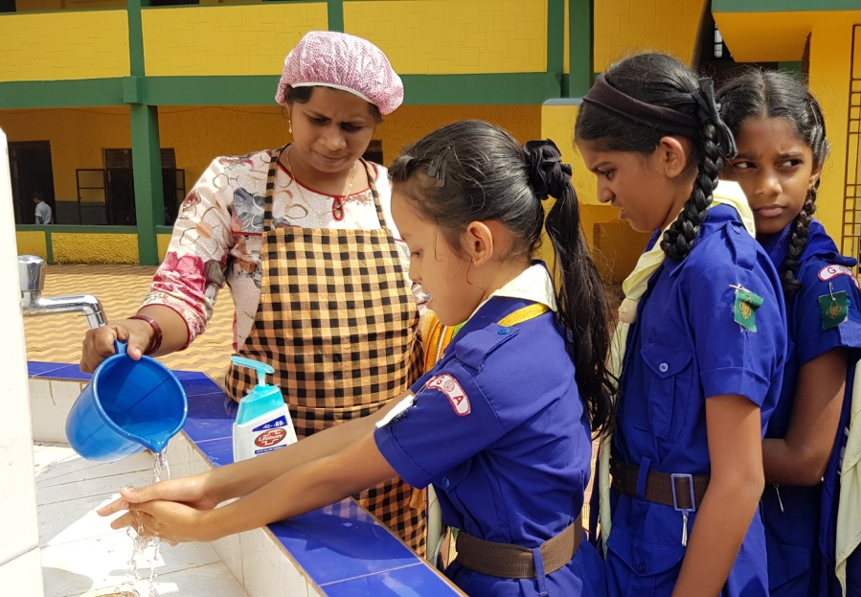
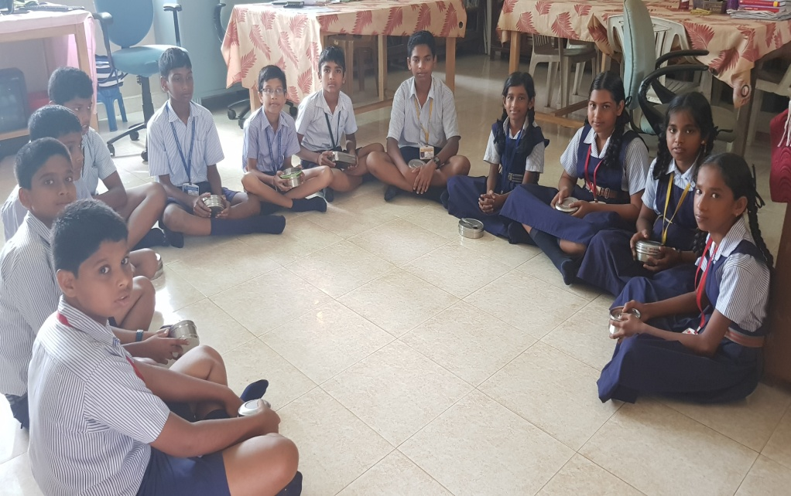
Inspections under Mid Day Meal Scheme

Slide 27
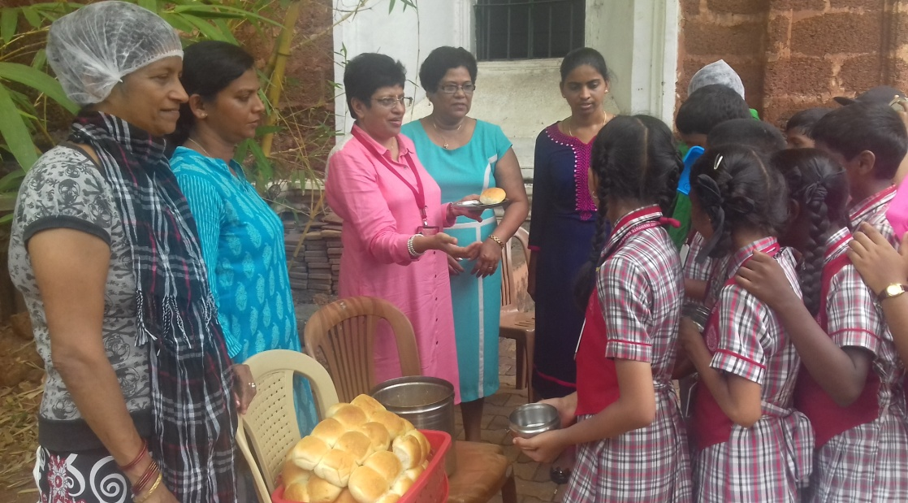
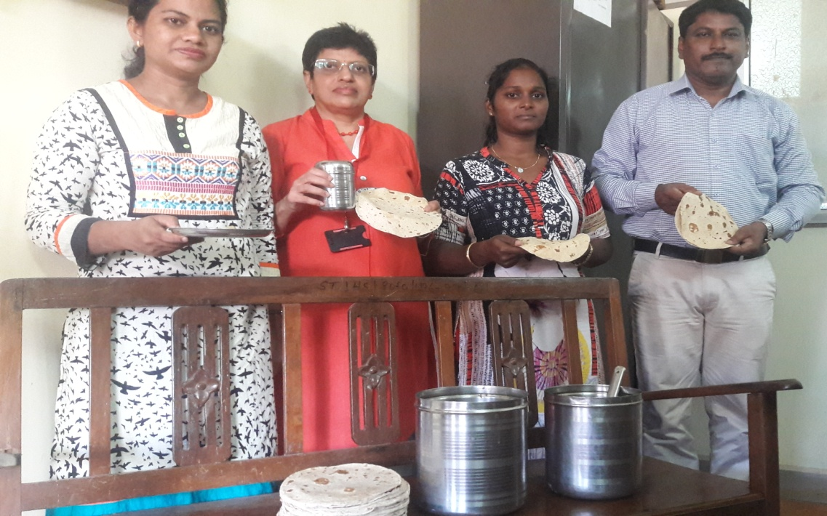
Inspections of Mid Day Meal

Slide 28
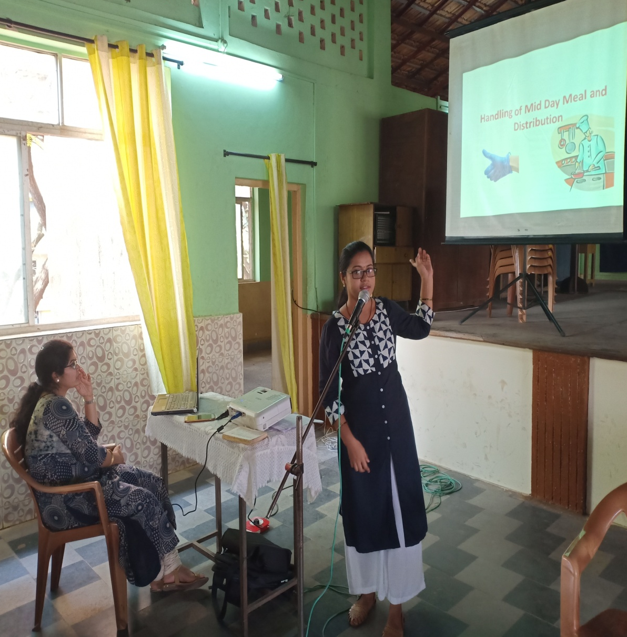
Training given to CCH on Food Safety, Hygiene and Distribution of Mid Day meal

Slide 29
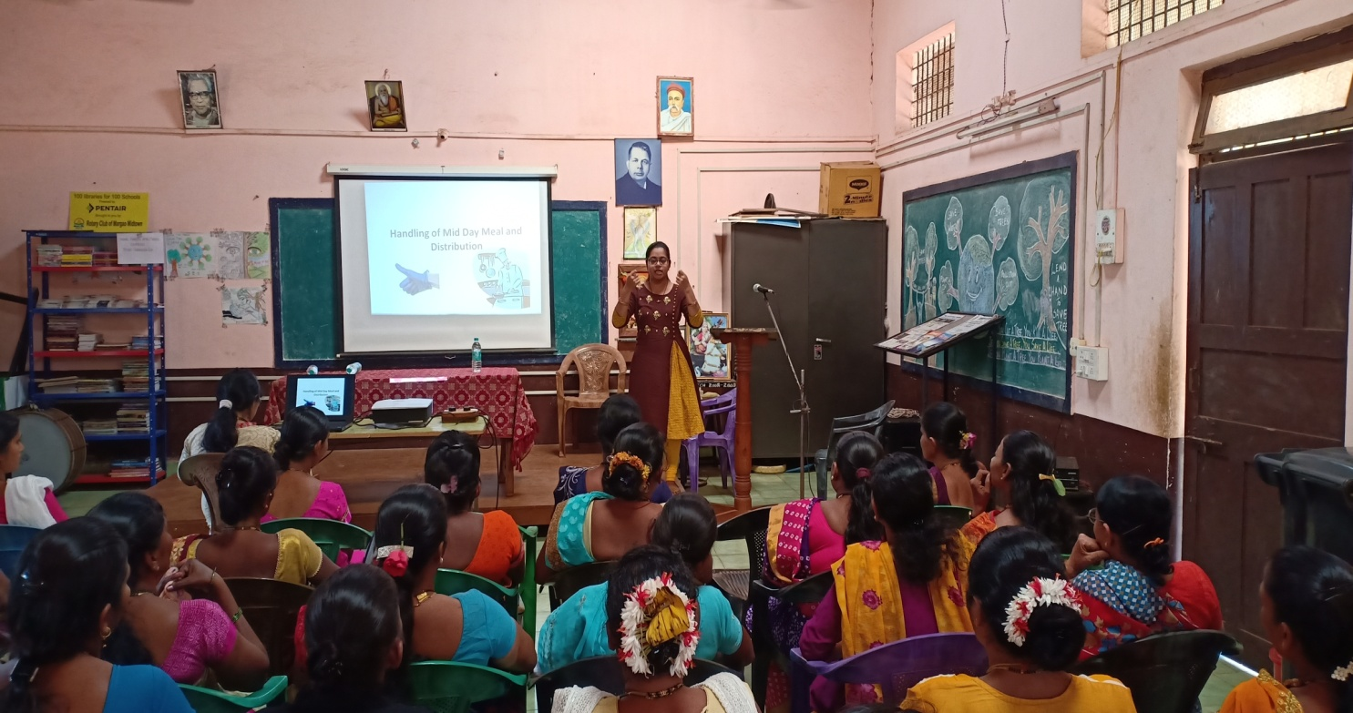

Slide 30
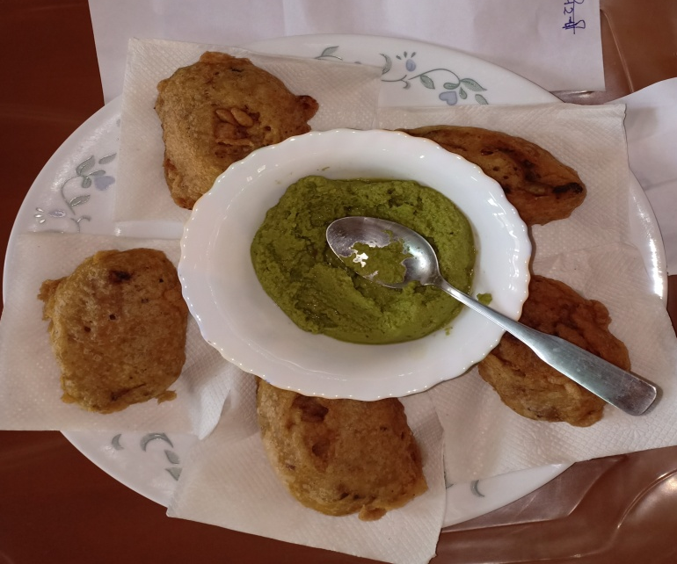
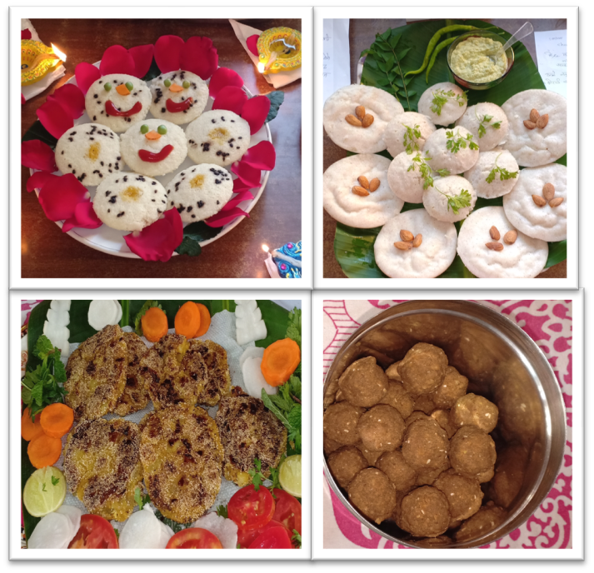
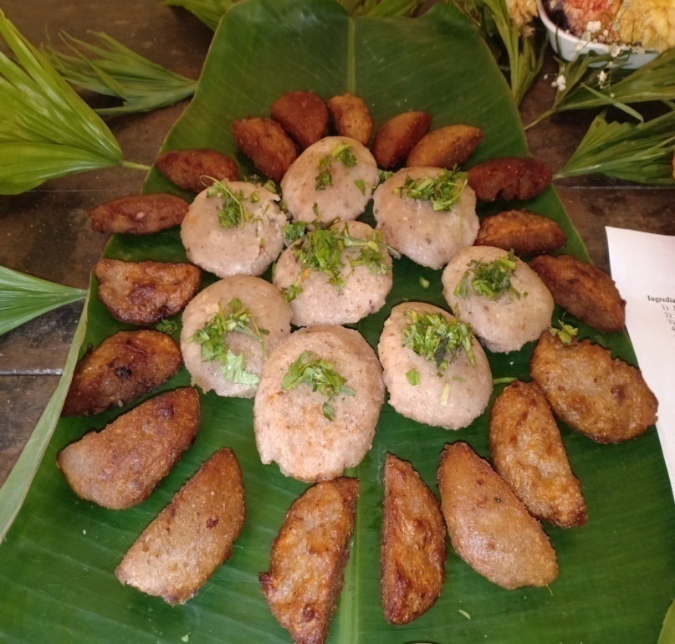
Various Healthy Nutritious Recipes Presented for Cooking Competition

Slide 31
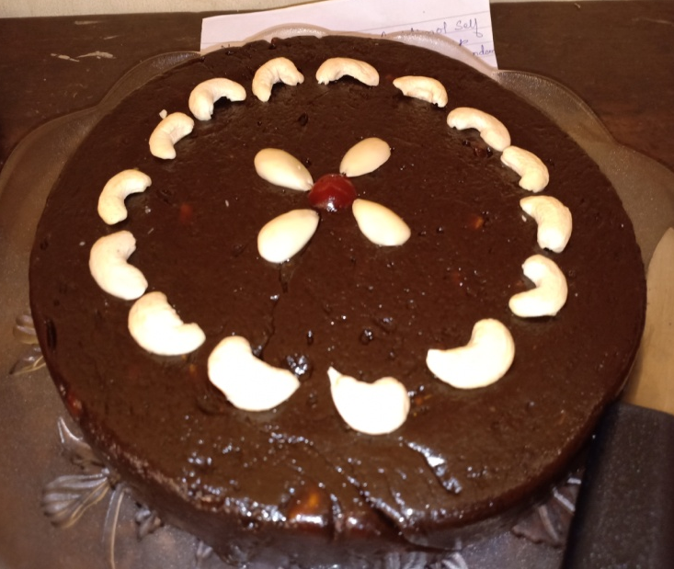

Slide 33
Cooking competitions judged by the Nutrition Experts

Slide 34
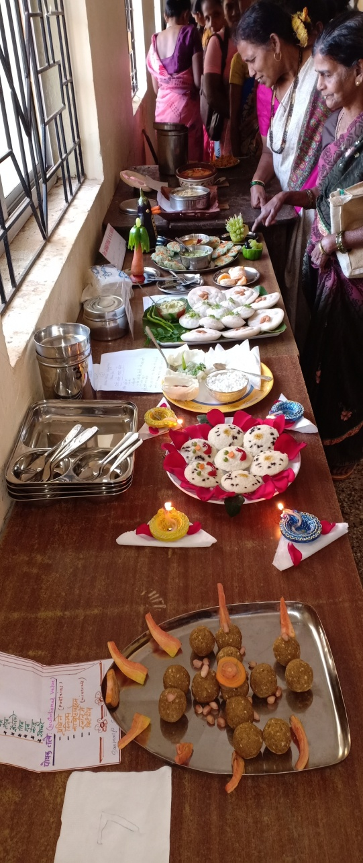
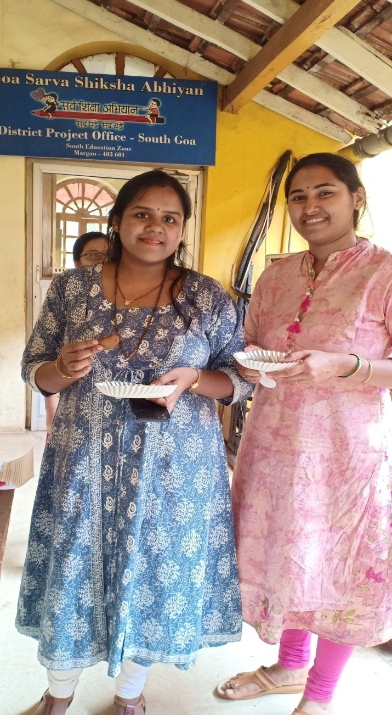
Cooking competitions judged by the Nutrition Experts

Slide 35
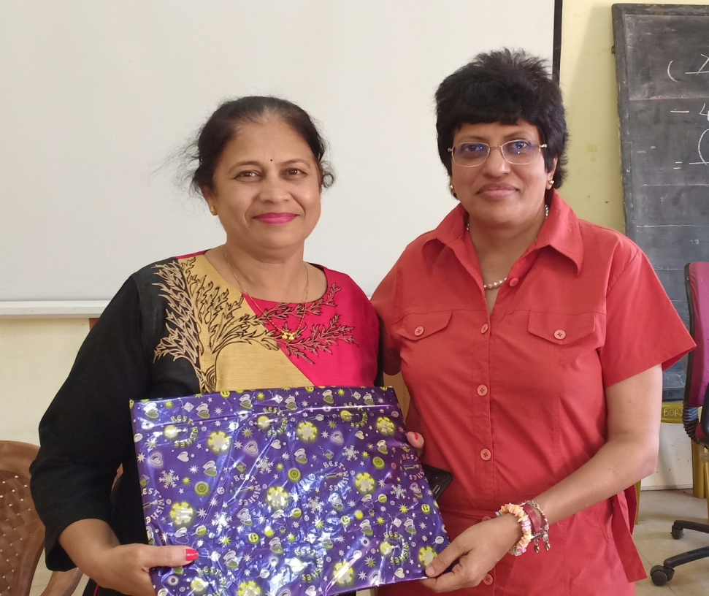
Some of the Winners of the competitions

Slide 36
THANK YOU

